Slide 1
Project Stock Management
Dev Challenge

Slide 2


Goal
Web Page
Web API (MongoDb)
Unit Tests
Web Page
Web API
Docker
Mongo
Tiago Costa
Rui Pedro
Ricardo Jorge

Slide 3
Web Page Required actions
Responsive
React
Screens
Product
Add Product
Stock In / Stock Out

Slide 4
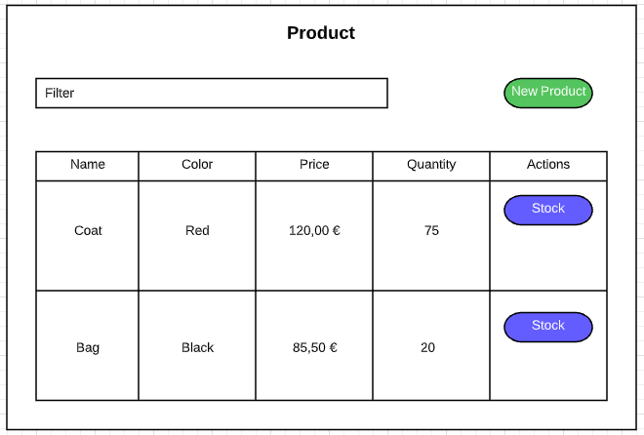
Web Page Wireframe

Slide 5
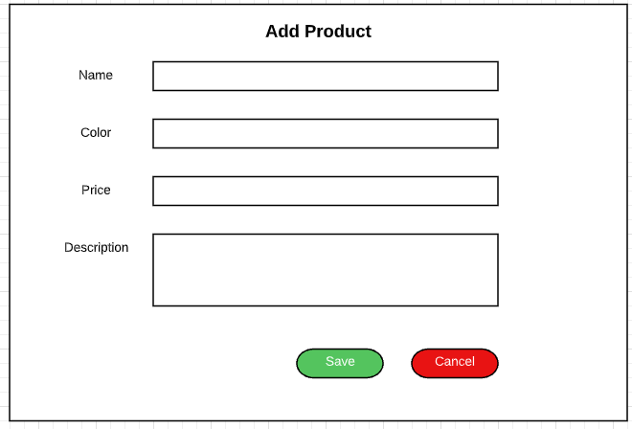
Web Page Wireframe

Slide 6
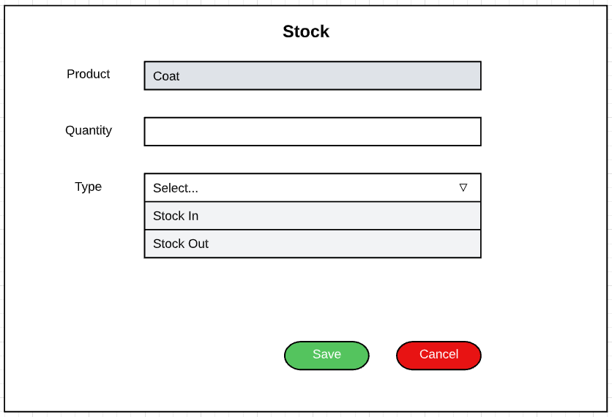
Web Page Wireframe

Slide 7
Web API Required actions
.NET Core
Dependency Injection
Event Log (CreateDate, CreationUser, UpdateDate, UpdaterUser)
Unit Test (100% code coverage)
Methods
addProduct
getProduct
getProductDetail
getAllProducts
stockIn
stockOut

Slide 8
Let’s do it?

